Slide 1
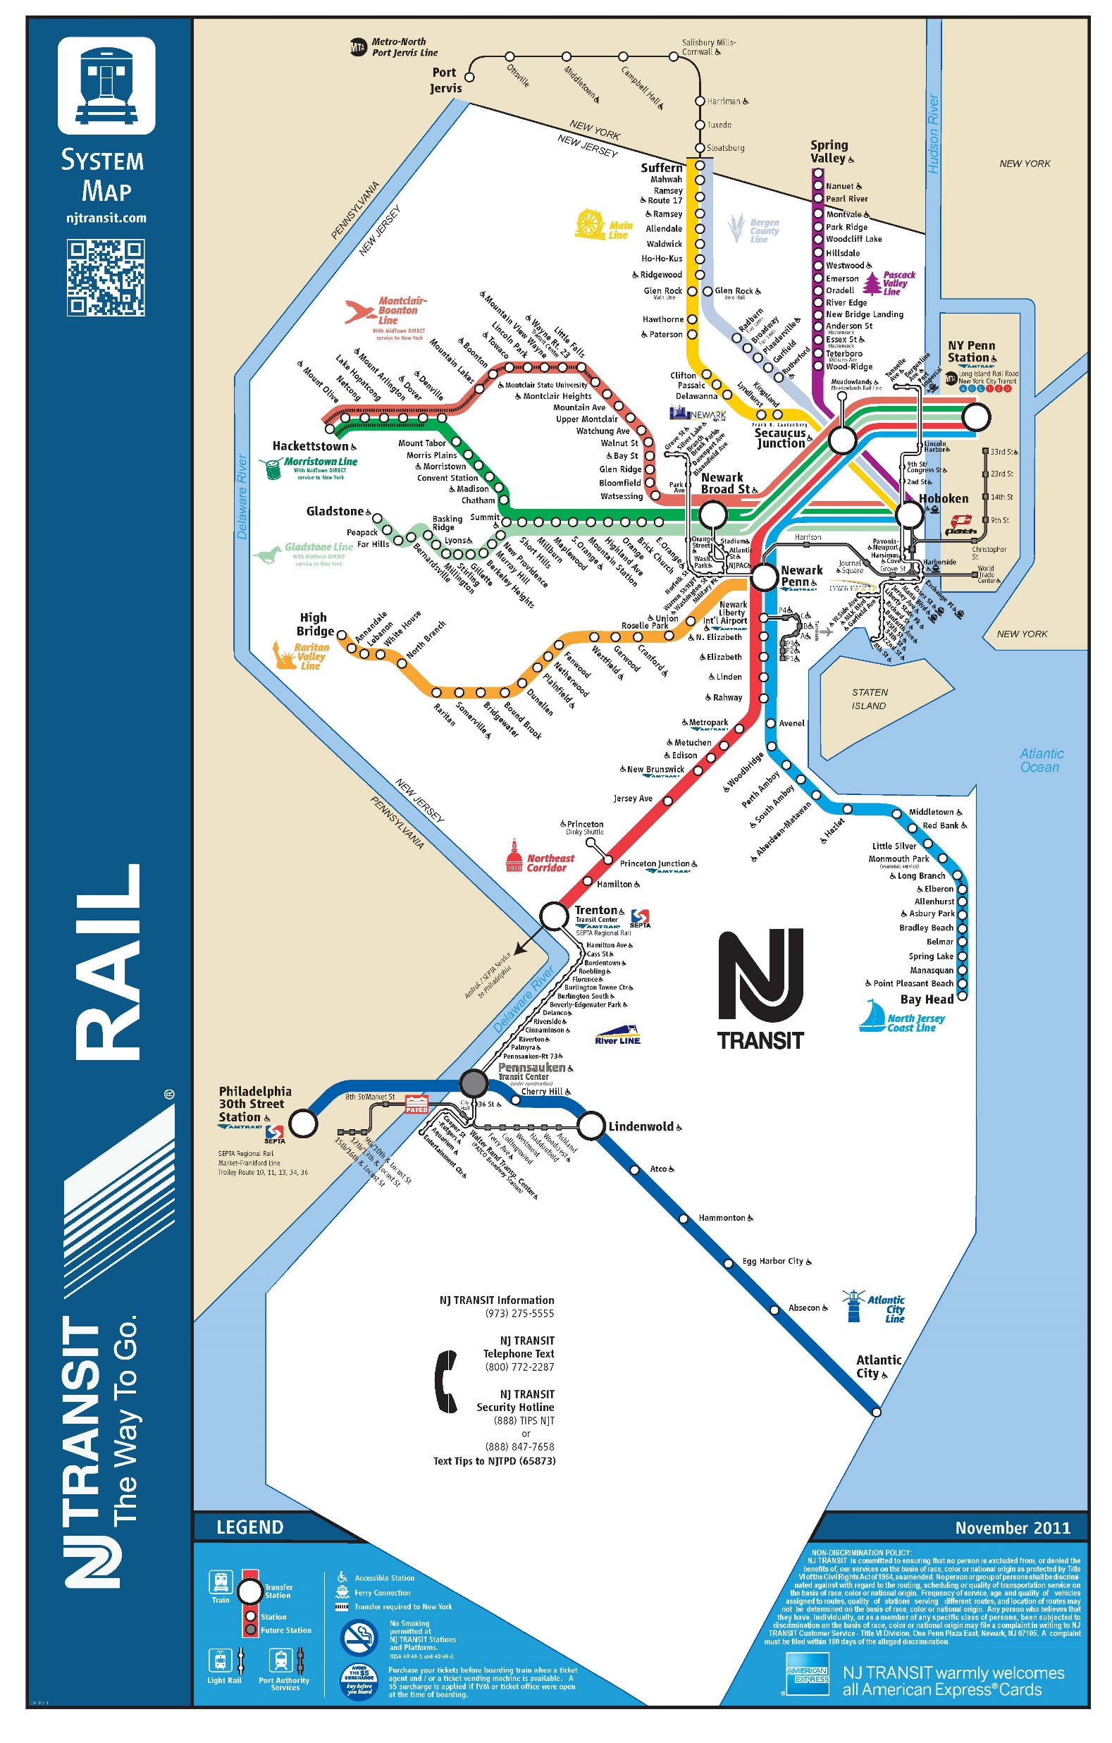
Delay Estimator
A Forecasting Tool for New Jersey Train Delay
MUSA 508 Fall 2021
Final: Project 4
Jasmine Siyu Wu and Zoe Yoo

Slide 2
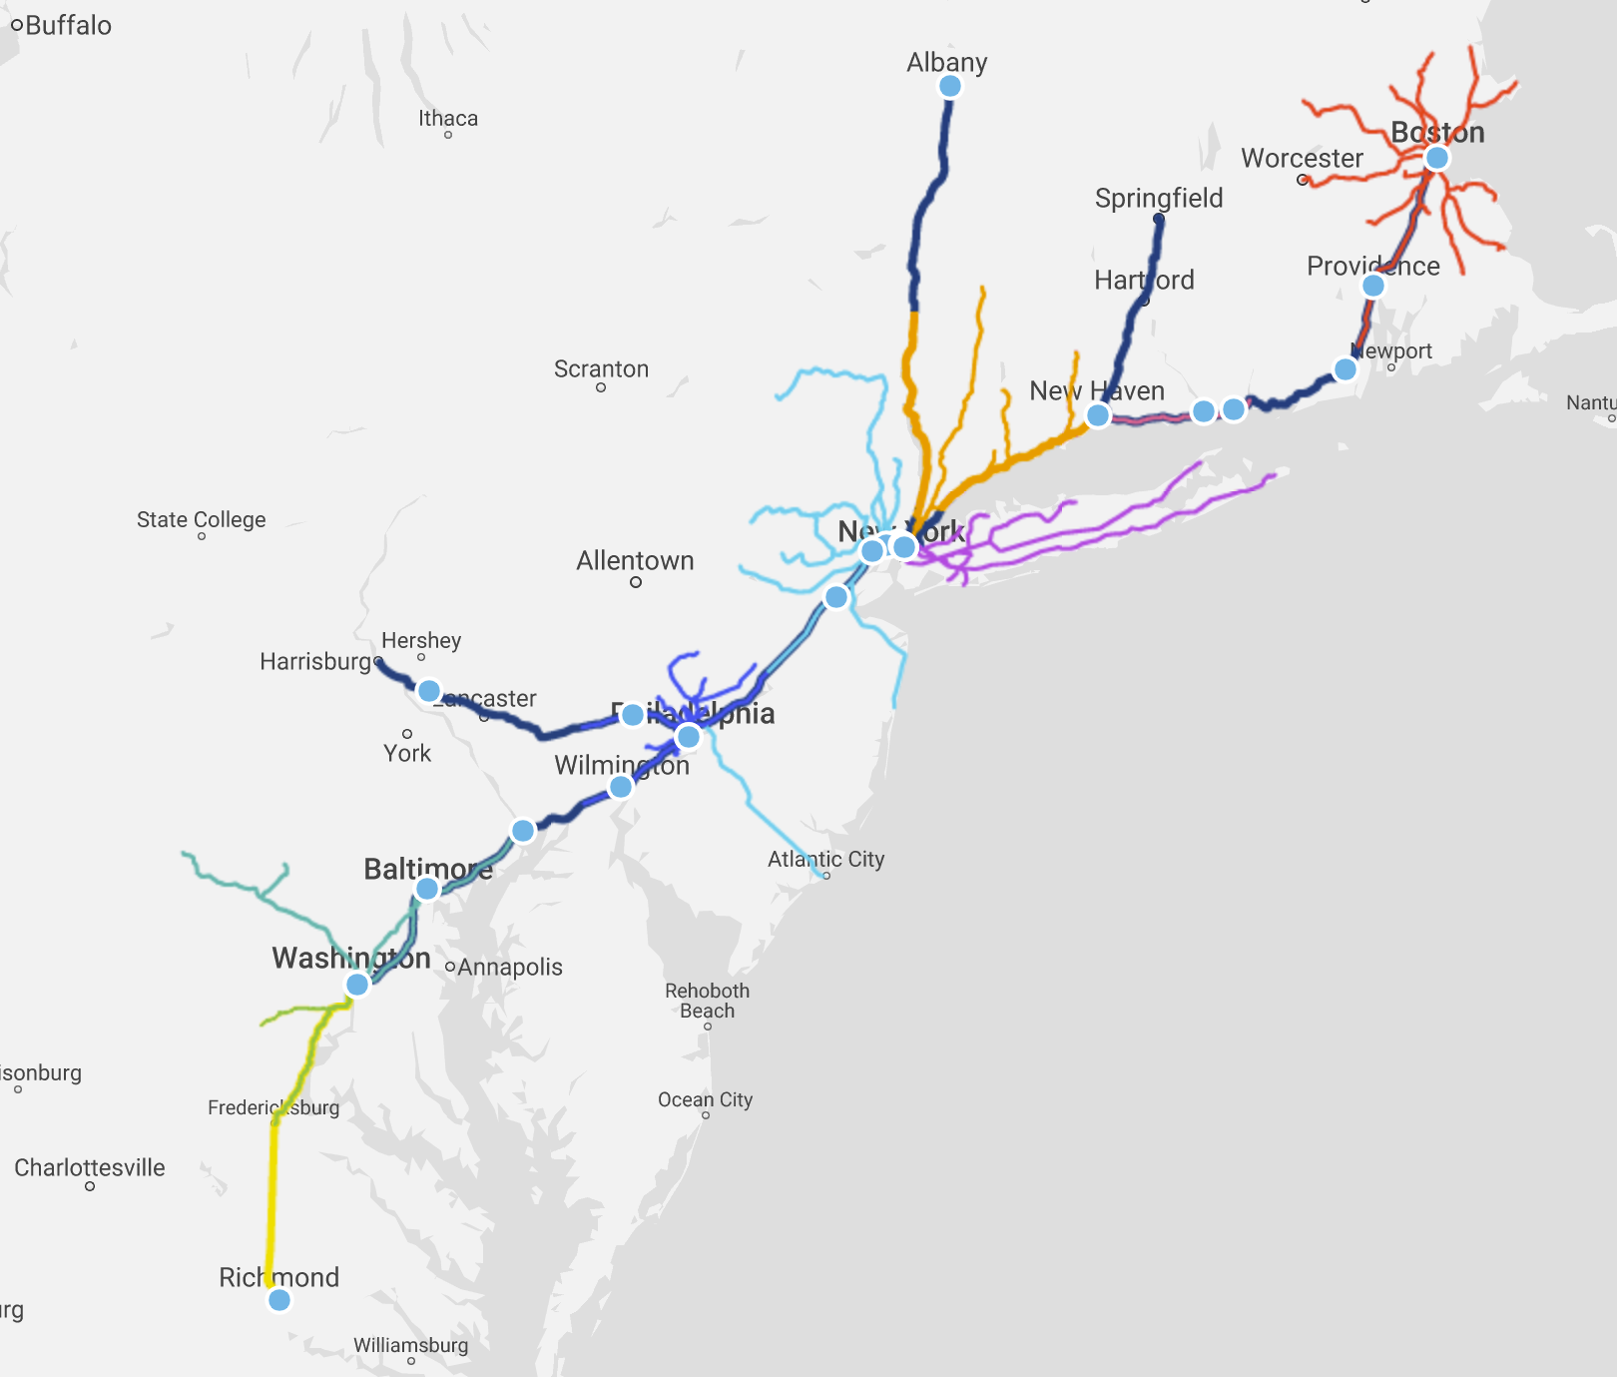
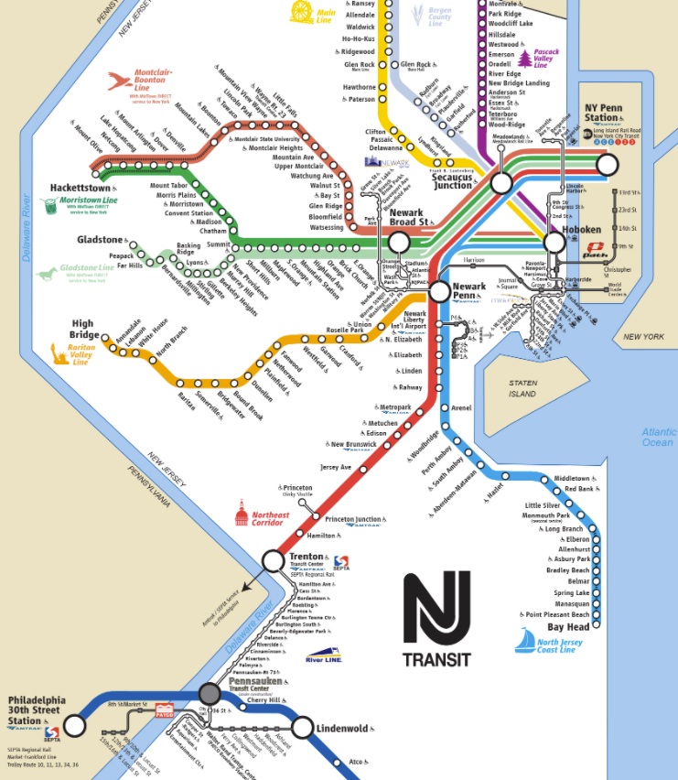

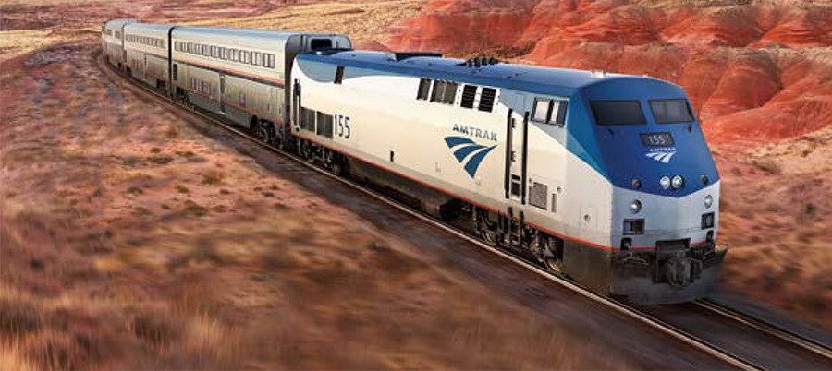
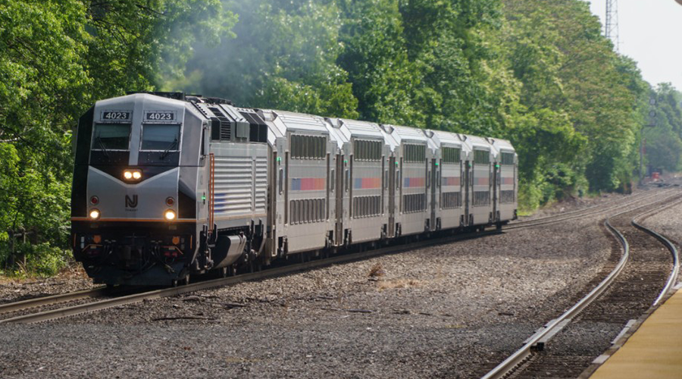
Scope
Initial idea to develop delay estimates for Amtrak and NJ online ticketing
Similar geographies, but data constraints
No scheduling times in Amtrak data
Photo sources: Amtrak, NJ Transit

Slide 3
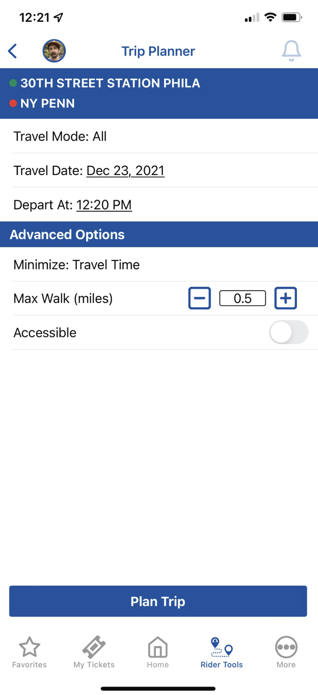

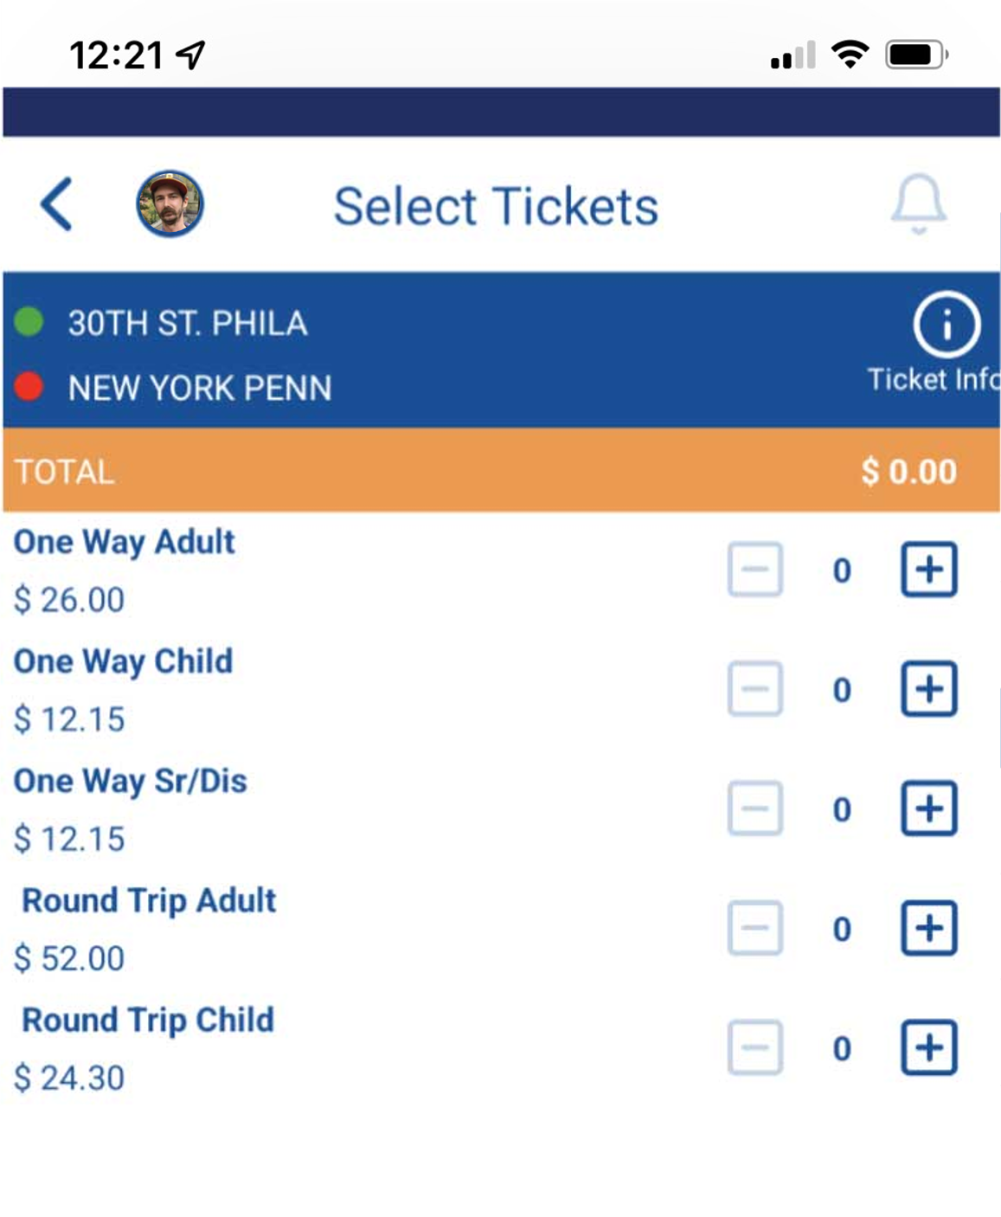
NJ Transit
New Jersey system differs from Amtrak
One-way tickets or passes, with no expiration date
Ticket prices vary based on distance but not time of reservation
Tickets can only be bought on the NJ Transit Mobile App or in-person
Trip Planner gives users scheduled trains based on date and time

Slide 4
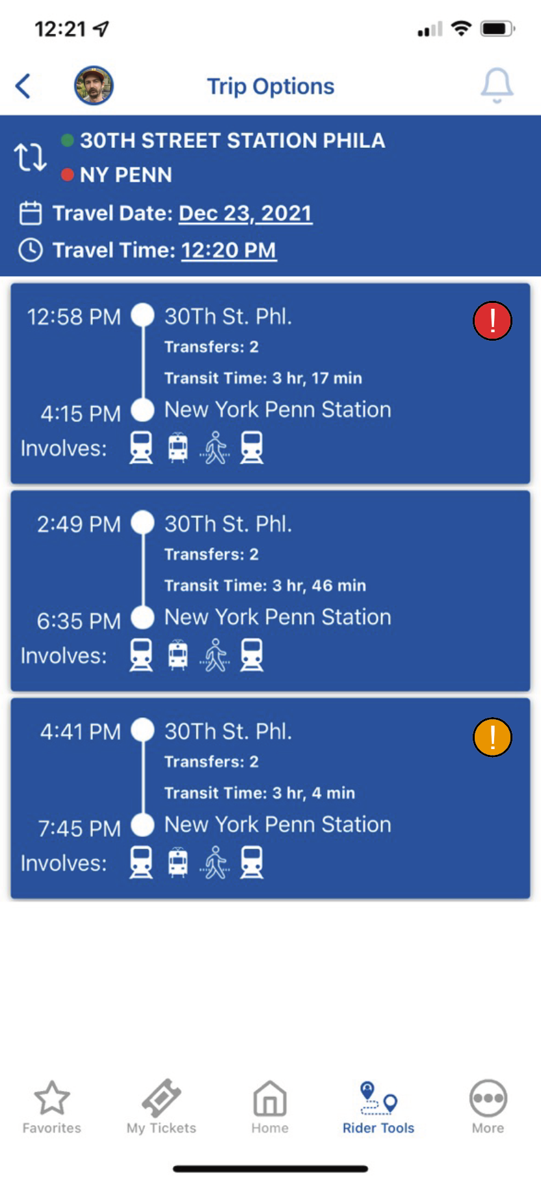



Trip Option Delay
Each time option shows the total predicted delay for that trip
Red = >30 minutes combined predicted delay
Orange = 20-30 minutes combined predicted delay
Yellow = 10-20 minutes combined predicted delay

Slide 5
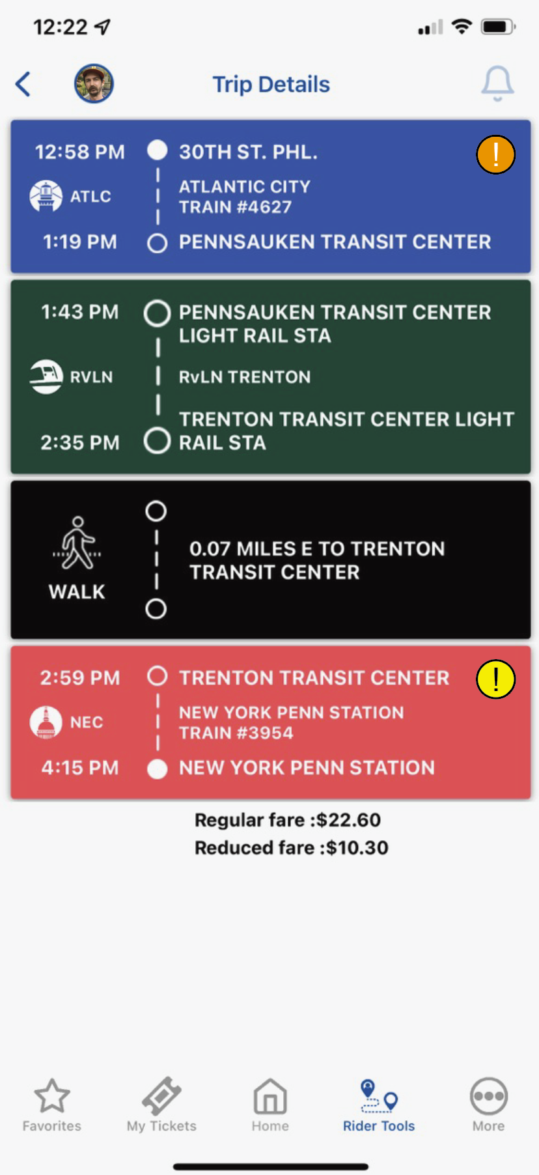
Detailed Trip View
Each leg of trip shows predicted possible delay
Categorized below and summed for the overall trip
Note: current data is only commuter rail, not light rail
Red = >30 minutes combined predicted delay
Orange = 20-30 minutes combined predicted delay
Yellow = 10-20 minutes combined predicted delay

Slide 6
Data Structure
NJ Transit DepartureVision Real Time Train Status Service
Aggregated on Kaggle by Pranav Badami
Sample months: January and February 2021
Basic Data
Train ID
Type (Amtrak or NJT)
Spatial Data
Start Station Name and ID
End Station Name and ID
Stop Sequence Number
Line Name
Temporal Data
Scheduled Time of Departure
Actual Time of Departure
Calculated Delay (minutes)
Date

Slide 7
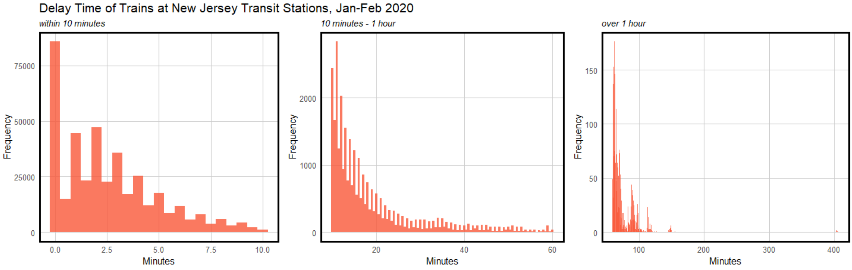
Reviewing the Data
Is delay often / severe enough to warrant a tool for it?

Slide 8
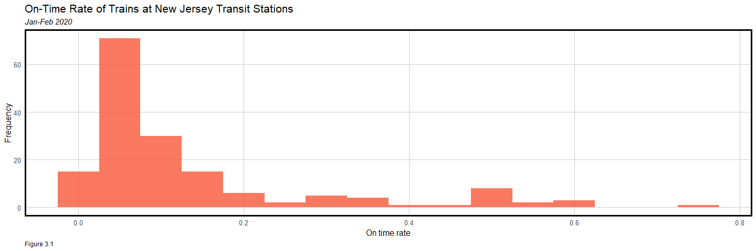
On Time
On time: % of trains arriving at the scheduled time at each station stop on a journey
Definition source: Southern Railway, “Train service punctuality and reliability”

Slide 9
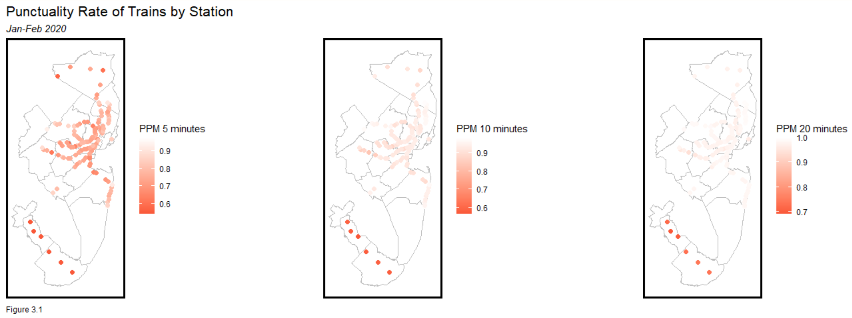
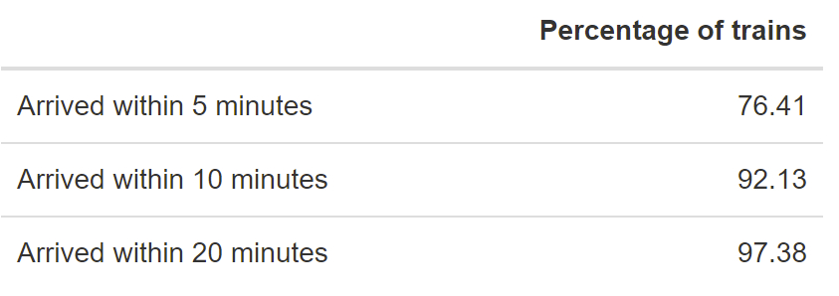
Public Performance Measure (PPM)
Public performance measure (PPM): % of trains arriving at their destination within 5 minutes of schedule
Philadelphia-Atlantic City Line has the lowest PPM
Definition source: Southern Railway, “Train service punctuality and reliability”

Slide 10
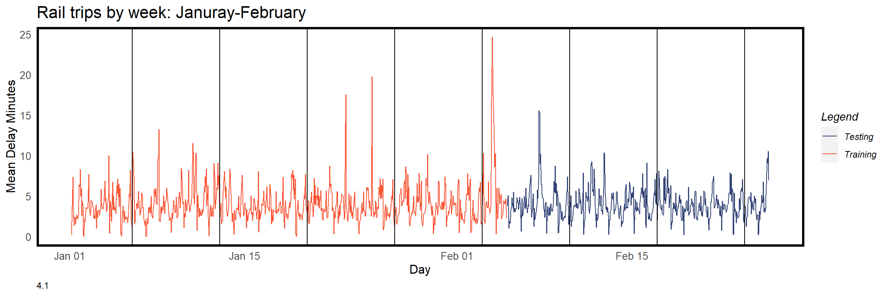
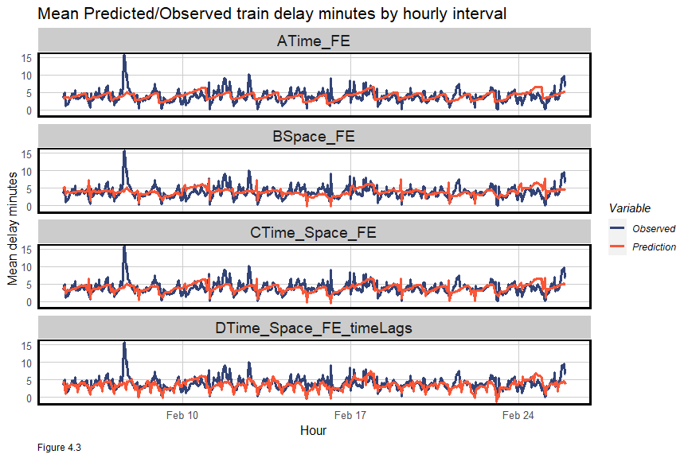
Regression Model
Split: Train on first five weeks, test on last three
Four different models:
A. Time – time of day, day of the week
B. Space – origin and destination stations
C. Time, Space, Weather (temperature/precipitation)
D. Time, Space, Weather, & Time Lag

Slide 11
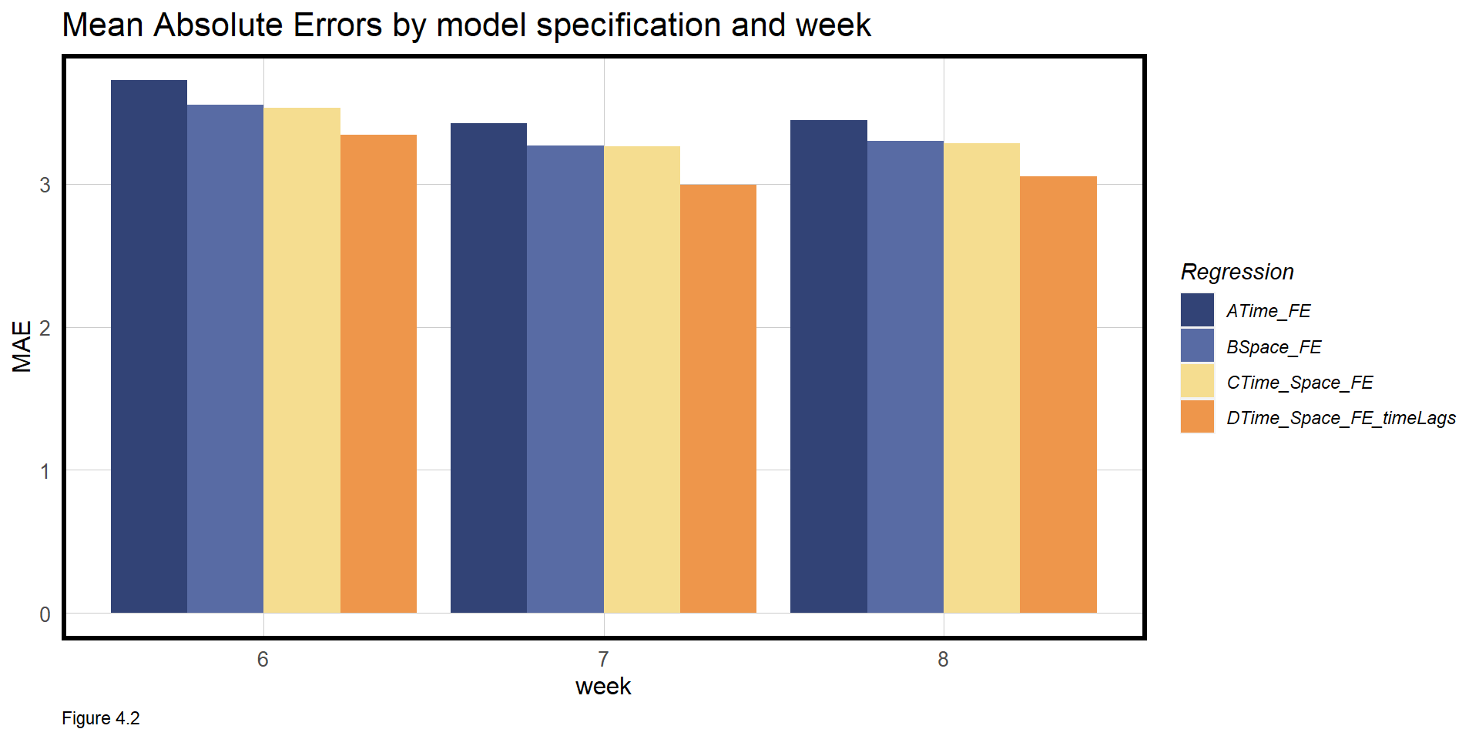
Results
Improving Accuracy
Greater computing power
Use a larger sample size of data to ideally gain more accuracy year-round
Improve on the current model
Add more variables, e.g. Number of previous stops
Add more independent data

Slide 12
Future Possibilities
Increase scope
Find scheduling data for Amtrak
Expand data scope to SEPTA or NJ light rail, which connect to NJ Rail Transit
Other uses
Use to figure out the possible causes delay, and how to mitigate it, before it has the chance to affect customers

